Slide 1


KNN(K–Nearest Neighbors)
ML IEEE – SSCS

Slide 2


Topics
What is KNN ?
What K Represent ?
How it is Work ?
Implementation of KNN
WorkShop

Slide 3
What is KNN ?
Supervised Learning
Classification
KNN (K–Nearest Neighbors )
KNN : is a simple algorithm that stores all the available cases and classifies the new data or case based on a Similarity Measure .
KNN also Know as is a Non-parametric Machine Learning Algorithm, which uses proximity to make classifications or predictions about the grouping of an individual data point.

Slide 4
What K Represent ?
The k value in the k-NN algorithm defines how many neighbors will be checked to determine the classification of a specific query point.
For example, if k=1, the instance will be assigned to the same class as its single nearest neighbor.

Slide 5
Discussion
Which model is better between K=1 and K=15?
Why ?

Slide 6
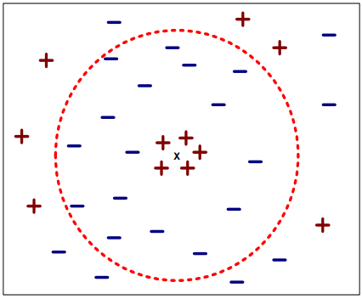
Choosing the value of k :
If k is too small, sensitive to noise points
If k is too large, neighborhood may include points from other classes

Slide 7
So What is Similarity Measure ?
Similarity : is a way of measuring how data samples are related or closed to each other.
> is usually expressed as a numerical value
> Is higher when two point are more alike.
> Often falls in the range [0,1]
Dissimilarity

Slide 8
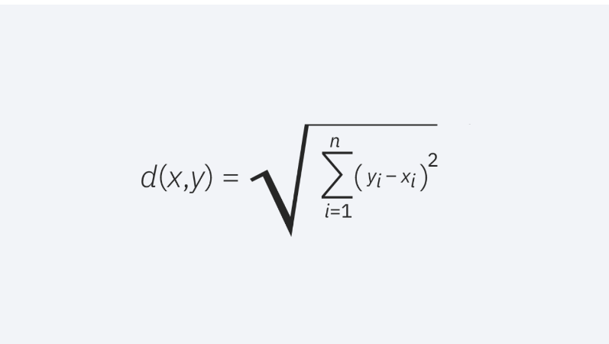
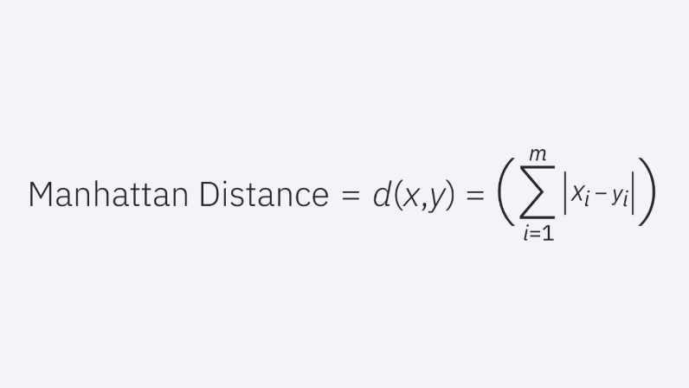
Determine the method of measure (Metrics)
Euclidean distance
Manhattan distance (

Slide 9
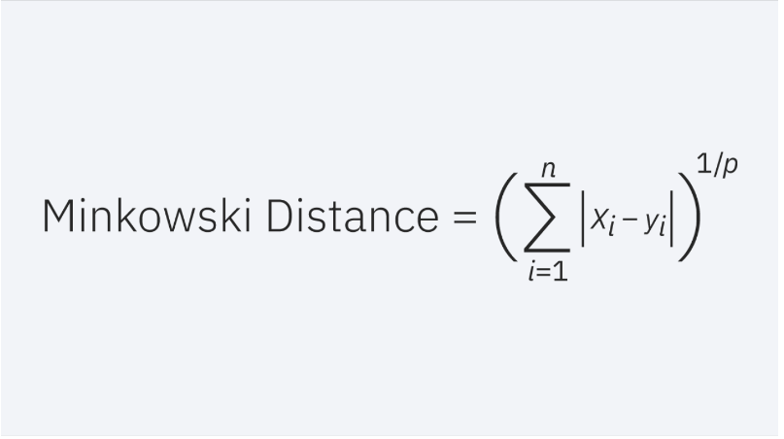
Minkowski Distance : This distance measure is the generalized form of Euclidean and Manhattan distance metrics. The parameter, p, in the formula below, allows for the creation of other distance metrics. Euclidean distance is represented by this formula when p is equal to two, and Manhattan distance is denoted with p equal to one..

Slide 10
How it is Work ?
Step -1 : Select the number K of the neighbors
Step-2 : Calculate the Euclidean distance of K number of neighbors
Step-3 : Take the K nearest neighbors as per the calculated Euclidean distance.
Step-4 : Among these k neighbors, count the number of the data points in each category.
Step-5 : Assign the new data points to that category for which the number of the neighbor is maximum.
Step-6 : Our model is ready.

Slide 11
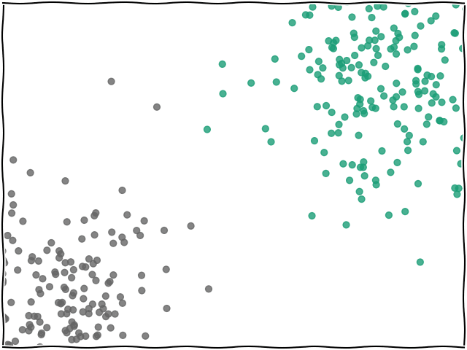

Slide 12
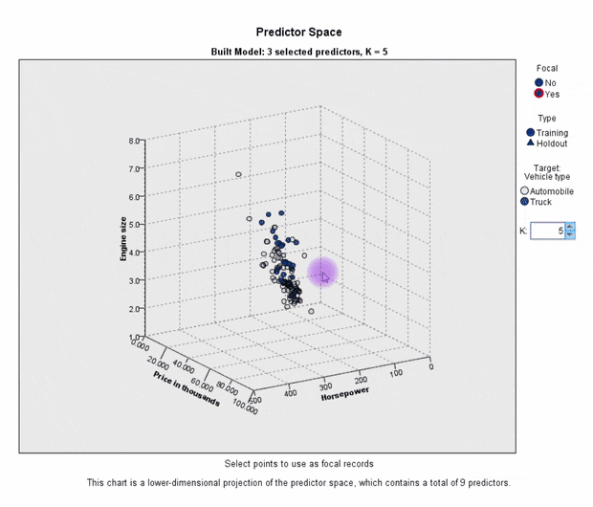

Slide 13
Implementation of KNN

Slide 14
WorkShop

Slide 15
Logistic Regression
ML IEEE – SSCS

Slide 16
Topics
Gradient Descent Recap.
Classification vs Regression.
logistic regression
Binary cross Entropy
GPT Answers

Slide 17
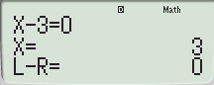
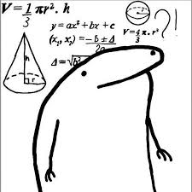
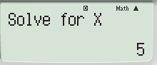


Gradient Descent Recap
How do u think calculator will solve this :
If we look carefully, what do you think the term $L−R=0$means?
Ok!
$L−R$ is the Error produced by the calculation
Solve for x means what is the initial value you want to substitute in x
So after this operation $E =L−R=X−3=2$

Slide 18
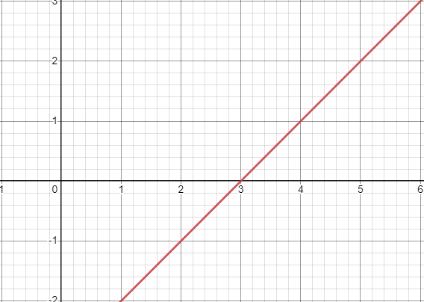

Gradient Descent Recap
Lets Draw the Graph $E =L−R=X−3$
How to solve this problem?

Slide 19
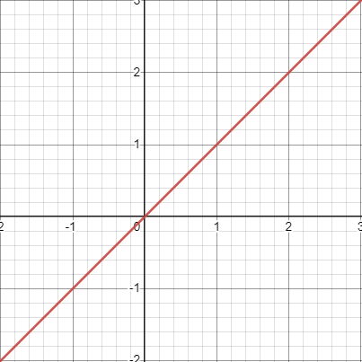
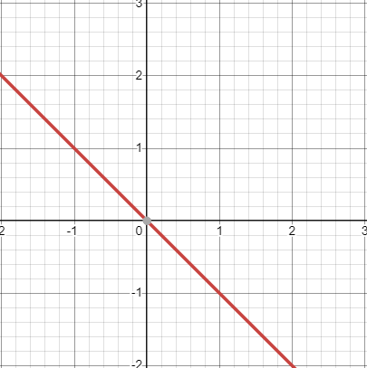



Gradient Descent Recap
How to slide?
Assume we start at point at x = 2 and we want to slide to ∞.
$$y=x$$
$$x_{new}=x_{old}− ∝∗\frac{dE}{dx}$$
$$y=−x$$

Slide 20
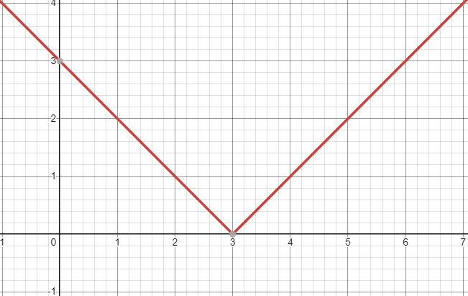

Gradient Descent Recap
$$E= \left|L−R\right|$$
What do you think the problem with this function?

Slide 21
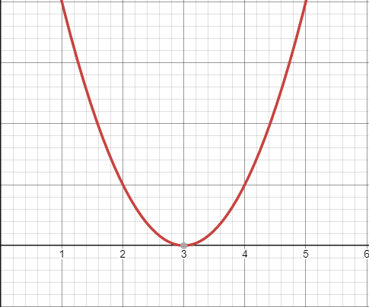

Gradient Descent Recap
$${E=(L−R)}^{2}$$
👍
Lets see a simulation!

Slide 22
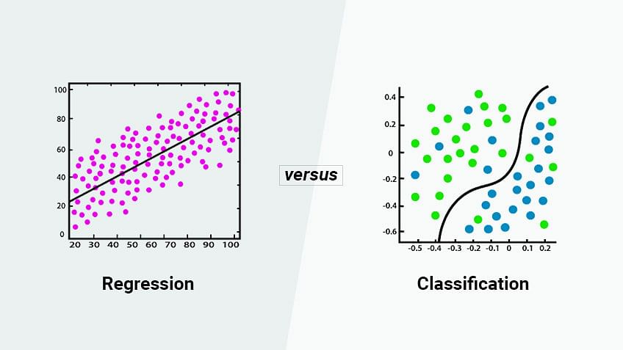

logistic regression
What we have just learning was how to fit a continuous data, but how to do classification?

Slide 23
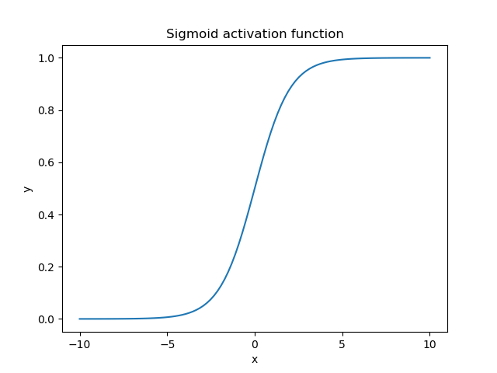
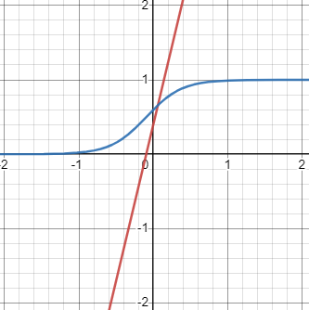
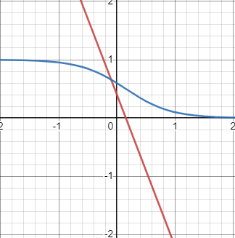

logistic regression
$$y_{predicted}= \frac{1}{1+e^{−z}}, z=w∗x+b$$
Lets see a simulation!

Slide 24
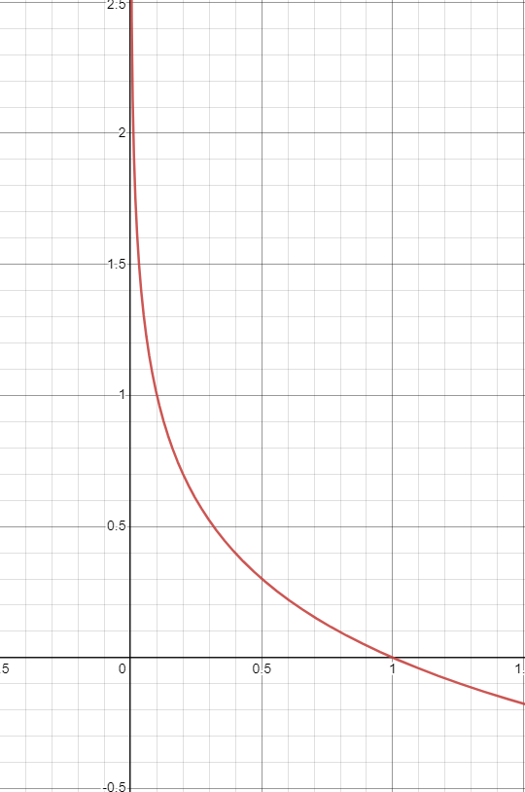
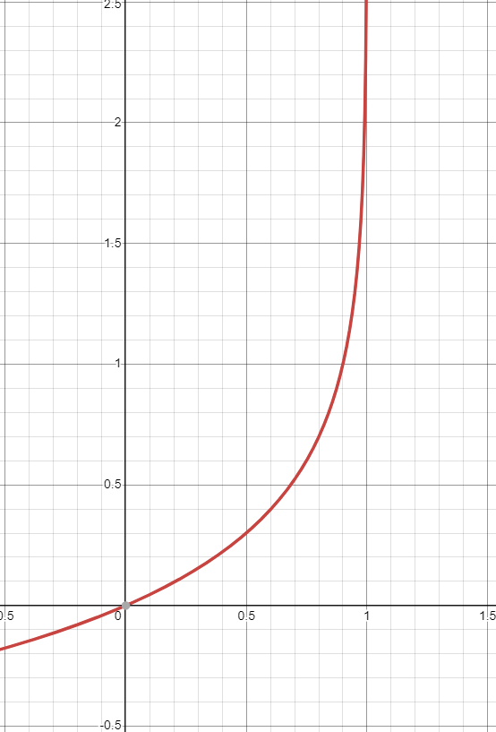
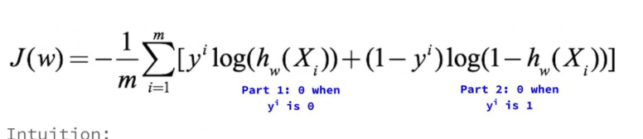

logistic regression
How to fit?
What is the loss )MSE or something else(?
$$E=\left\{\begin{aligned}−\log\left(y_{pred}\right), y=1 \\ −\log\left(1−y_{pred}\right), y=0\end{aligned}\right.$$
binary cross entropy (also known as binary log loss or logistic loss)

Slide 25
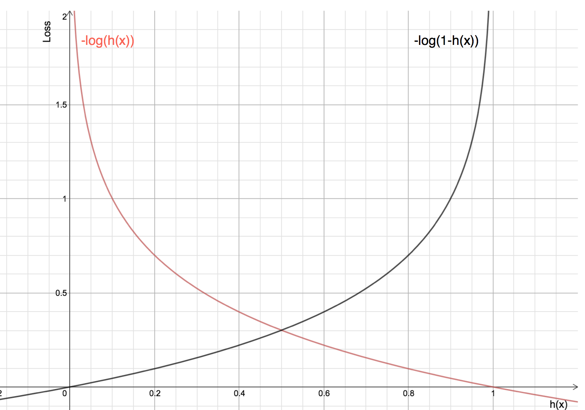

Slide 26

logistic regression
What is the loss differentiate with respect to parameters?
According to chain rule:
$\frac{∂L}{∂z}=\frac{∂L}{∂a}∗\frac{∂a}{∂sig}∗\frac{∂sig}{∂z}=y_{pred} −y_{real}$
$\frac{∂L}{∂w}=\left(y_{pred} −y_{real}\right)∗X$
$\frac{∂L}{∂b}=\left(y_{pred} −y_{real}\right)$

Slide 27
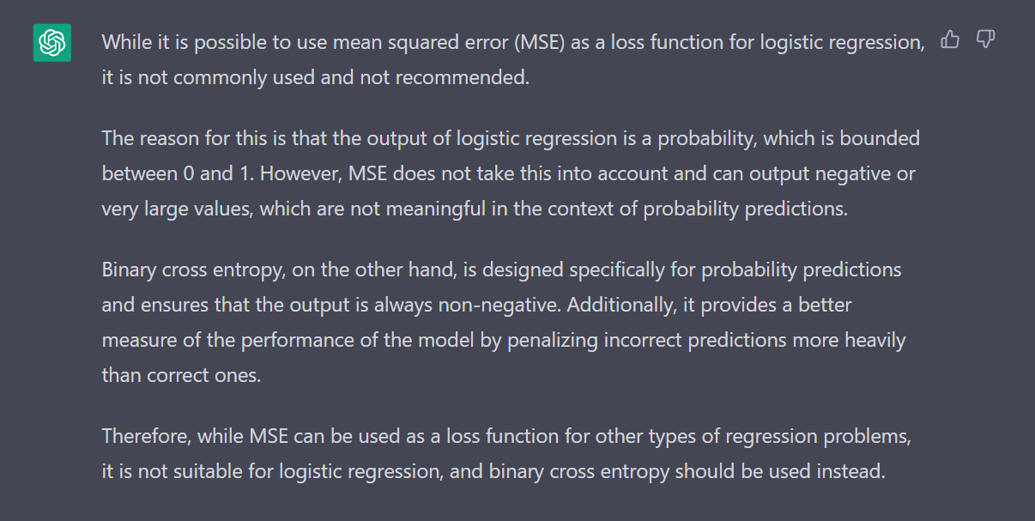

Slide 28
